Slide 1

Global Economic and Demographic Data
Global
Economic
and
Demographic
Dashboard

Slide 2
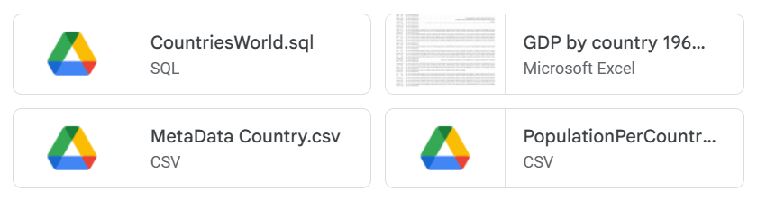
DATA

Slide 3
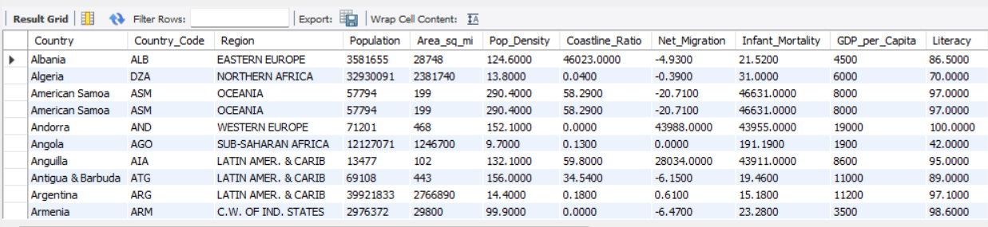
DATA export

Slide 4
Country
Population
Coastline (coast/area ratio)
GDP ($ per capita)
Climate
Agriculture(% of GDP)
Country Code
Area(sq.m)
Net migration
Phones
Birthrate
Industry(% of GDP)
Region
Population Density(per sq.mi.)
Infant mortality (per 1000 births)
Arable(%)
Deathrate
Literacy %
226
226
11
6490563468
135144118
381
1704037
1553948
13770
9783
2118767
3649906
2
2919247
29159
31%
59%
105242

Slide 5
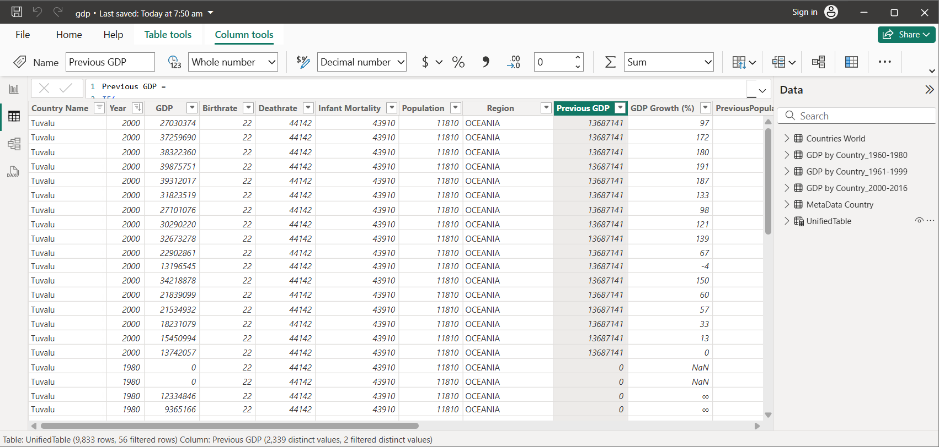

Slide 6
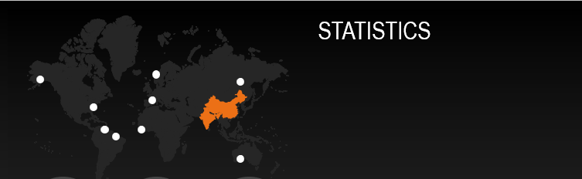
CHINA
Population 1313973713
Area 9596960
Population-Density 136.9
Infant -Mortality 24.18
Birthrate 13.25
Deathrate 35582
ST PIERRE & MIQUELON 7026
Area 242
Population-Density 29
Infant Mortality 19906
Birthrate 13.52
Deathrate 30468
AMERICAN SAMOA
Population 57794
Area 199
Population Density 290.4
CHINA
ST PIERRIE & MIQUELON
AMERICAN SAMOA

Slide 7
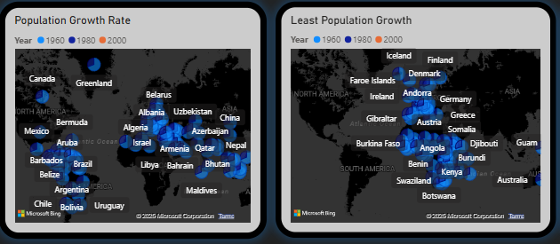
Growth Rate (%) =
[(Current population – Initial population) / current population] × 100
Adjusted Population
Previous population
Population growth

Slide 8
GROWTH TRENDS
POPULATION
Growth Trends for Population:
China (1,313,973,713)
India(1,095,351,995)
USA(298,444,215)
Indonesia(245,452,739 )
Brazil(188,078,227)
Pakistan (165,803,560)
Least Populated Countries:
St Pierre and Miquelon (7,026)
Saint Helena (7,052)
Montserrat (9,439)

Slide 9
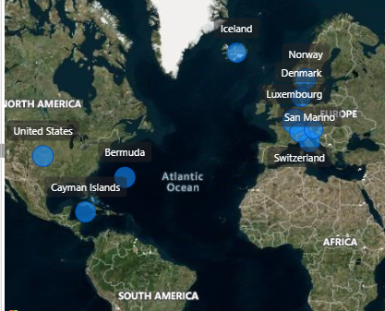
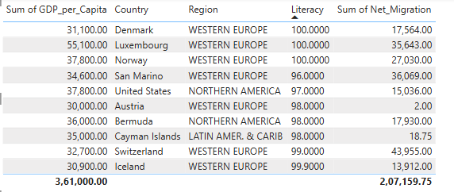
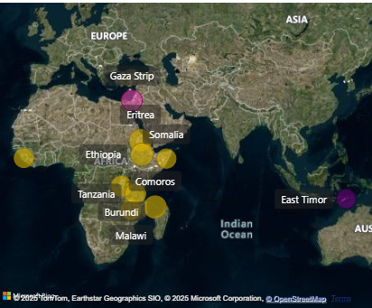
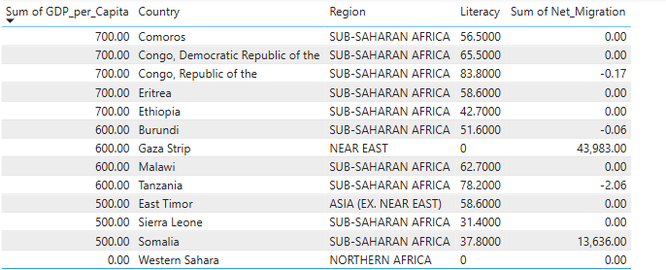
GDP PER CAPITA
Proof…
Element One
Element Two
Element Three
One
14%
462
22%
ORG
Two
Three
31%
Place additional content here. Your content can be placed in this area. Place more words here, if needed.
Place additional content here. Your content can be placed in this area. Place more words here, if needed.
Place additional content here. Your content can be placed in this area. Place more words here, if needed.
4,368,723
Element Four
Element Five
Element Six
Place additional content here, if needed. Your content can be placed in this area. Place more words here, if needed. Your goal is to use less text. Place more words here, if needed. Your content can be placed in this area. Place more words here, if needed. Place additional content here. Your content can be placed in this area.
43%
28%
82%
Place additional content here. Your content can be placed in this area. Place more words here, if needed.
Place additional content here. Your content can be placed in this area. Place more words here, if needed.
Place additional content here. Your content can be placed in this area. Place more words here, if needed.

Slide 10
GROWTH TRENDS
Growth Rate (%) = [(Current GDP – Initial GDP) / Initial GDP] × 100
GDP
Luxemborg
GDP Per Capita Income
$55100(Early 2000)
$1485-1960
$106,899-$141,080(Current Trend)
East Timor, Siera Leone, Somalia GDP Per Capita $500
Latvia, Croatia, South Africa Around $10000
Greenland, Guensay, Israel Around $20000

Slide 11
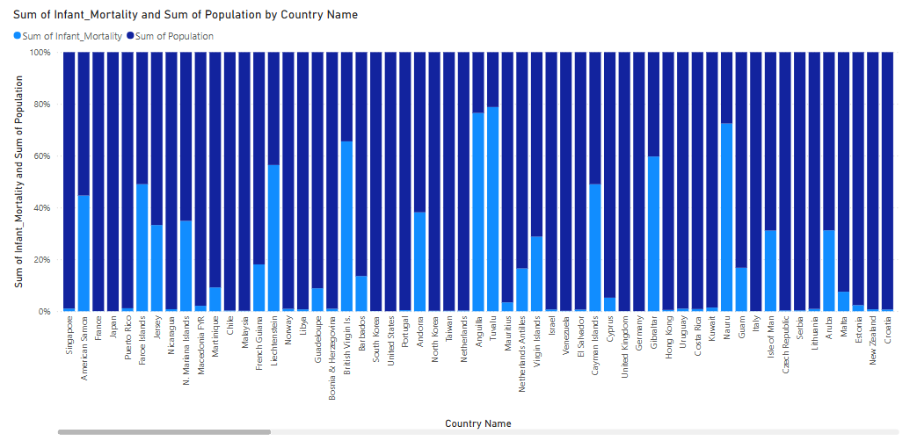
INFANT MORTALITY
MORTALITY-30,70,752
BIRTHS -29,19,248
American Samoa, Faroe Islands, France , Japan, Jersey,Macadonia,
Singapore
Faroe Islands-Population:47246
Mortality:45444

Slide 12
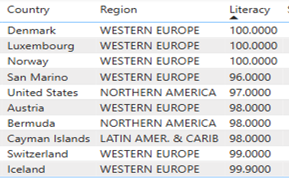
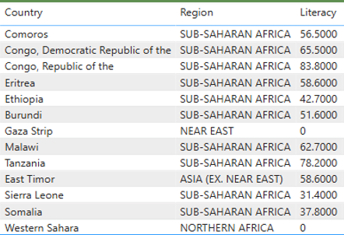
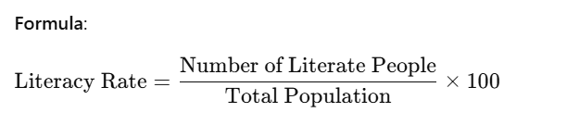
LITERACY
1,05,242

Slide 13
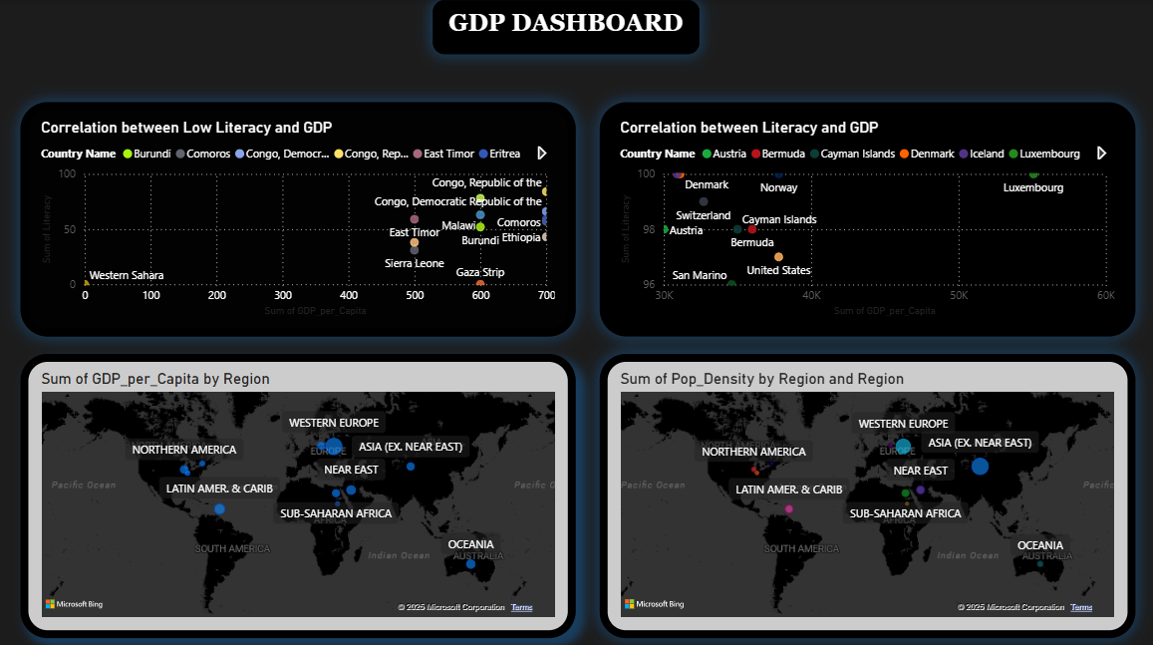

Slide 14
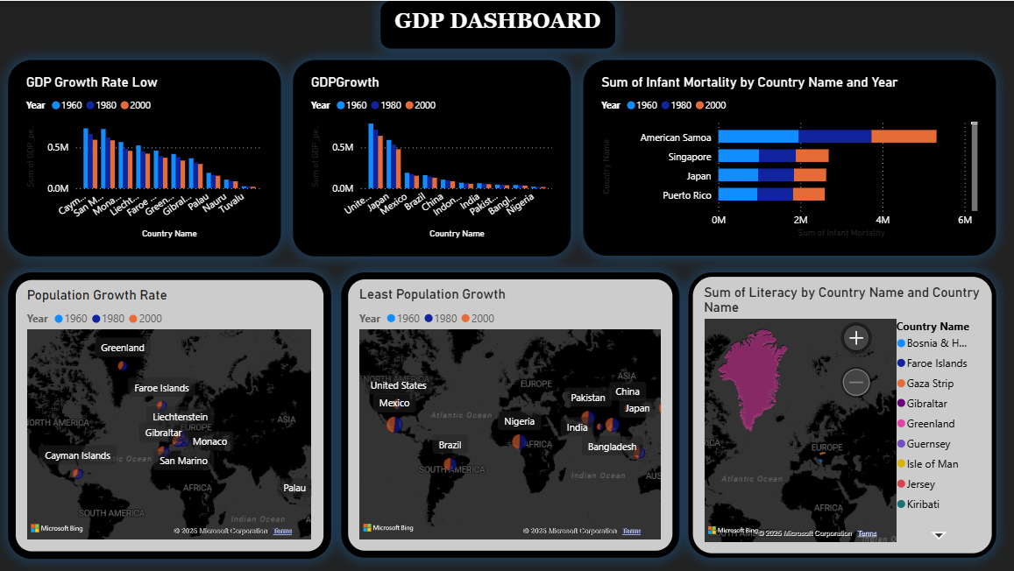

Slide 15
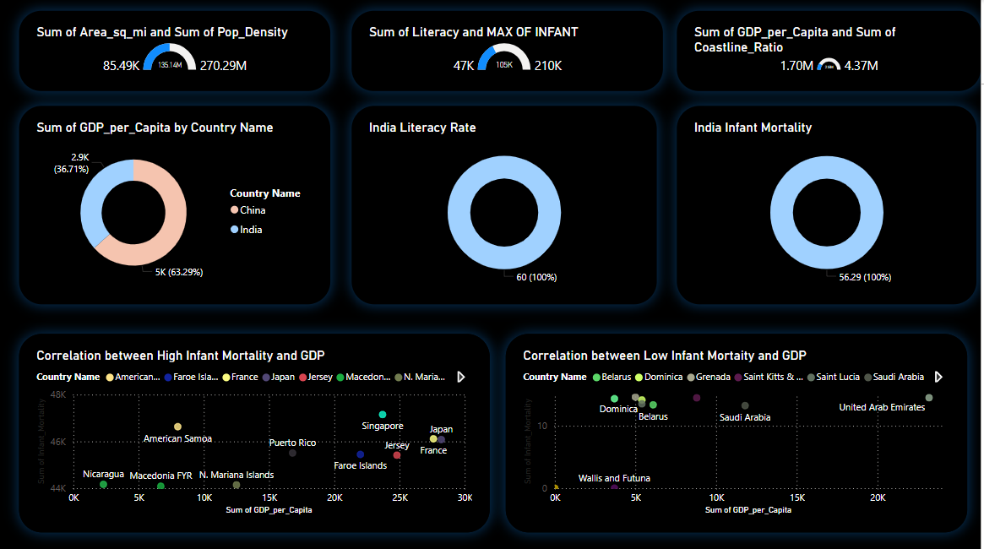

Slide 16
Conclusion
Trends:
Population Trend- Countries had significant rise in population but mortality rates were making a impact
GDP Trend- United States and other countries had growth due to fiscal support and economic resilence. China growth remained steady (2000-2016- 3.8%)
Infant Mortality –Countries like Afghanisthan and Somalia and other African countries had more than 1000 deaths
Literacy Trends-Sub-Saharan Africa and South Asia face the most significant challenges, with some countries reporting adult literacy rates below 30%

